Slide 1


Cancer Patient Data Analysis
A comprehensive analysis of patient demographics, cancer types, and treatment outcomes to improve clinical decision-making

Slide 2
Agenda
01
02
03
Dataset Overview
SQL Data Preparation
Key Performance Indicators
Understanding our cancer patient database structure and key variables
Data cleaning and transformation methodology
Critical metrics for measuring treatment efficacy and patient outcomes
04
05
Dashboard Insights
Recommendations
Visual analysis of patient demographics, cancer types, and treatment outcomes
Data-driven suggestions for improving patient care and outcomes

Slide 3

Dataset Overview
Our analysis is based on a comprehensive cancer patient database, encompassing a variety of crucial data points:
Patient Demographics
Age, gender, and ethnicity to understand population trends.
Diagnosis Details
Cancer type, stage, and initial diagnosis date.
Treatment Protocols
Breast
Lung
Colorectal
Prostate
Lymphoma
Information on administered treatments and medications.
Other
Clinical Outcomes
Survival rates and other key patient outcomes.
Hospitalization Data
Duration of hospital stays and readmission rates.

Slide 4
SQL Data Preparation
Key SQL operations performed to prepare the dataset:
SELECT p.patient_id, p.age, p.gender, p.ethnicity, d.cancer_type, d.cancer_stage, t.treatment_type, t.start_date, t.end_date, DATEDIFF(day, t.start_date, t.end_date) AS treatment_duration, o.outcome_statusFROM patients pJOIN diagnosis d ON p.patient_id = d.patient_idJOIN treatments t ON p.patient_id = t.patient_idJOIN outcomes o ON p.patient_id = o.patient_idWHERE d.is_primary = 1 AND t.is_completed = 1ORDER BY p.patient_id;
Joining patient demographic tables with treatment records
Cleaning missing values and standardizing data formats
Creating calculated fields for treatment duration and response
Aggregating outcomes by demographic groups and cancer types

Slide 5
Key Performance Indicators
78%
62
14.2
23%
5-Year Survival Rate
Median Age
Avg Treatment Duration
Readmission Rate
Overall survival rate across all cancer types
Median patient age at diagnosis
30-day hospital readmission percentage
Average treatment duration in months
These KPIs provide a high-level overview of our patient population and treatment effectiveness, serving as benchmarks for improvement initiatives.

Slide 6
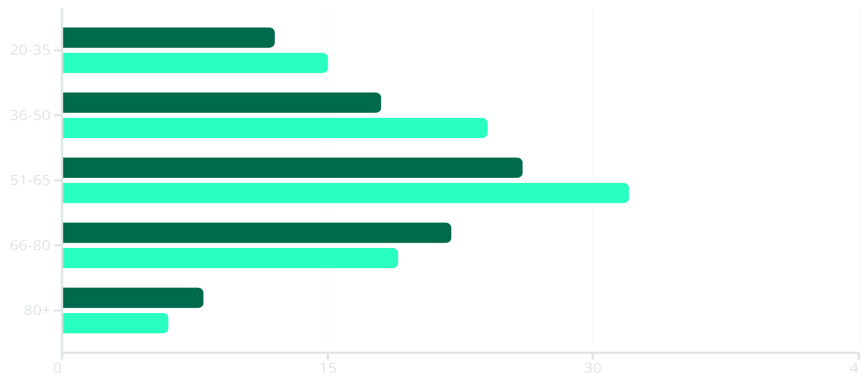
Patient Demographics Dashboard
Key Demographic Insights
Highest incidence in the 51-65 age group (58 patients)
Female patients outnumber males in younger age groups
Male patients show higher incidence in 66+ age groups
Male
Female
Median age at diagnosis: 62 years
Ethnic distribution reflects regional population demographics

Slide 7
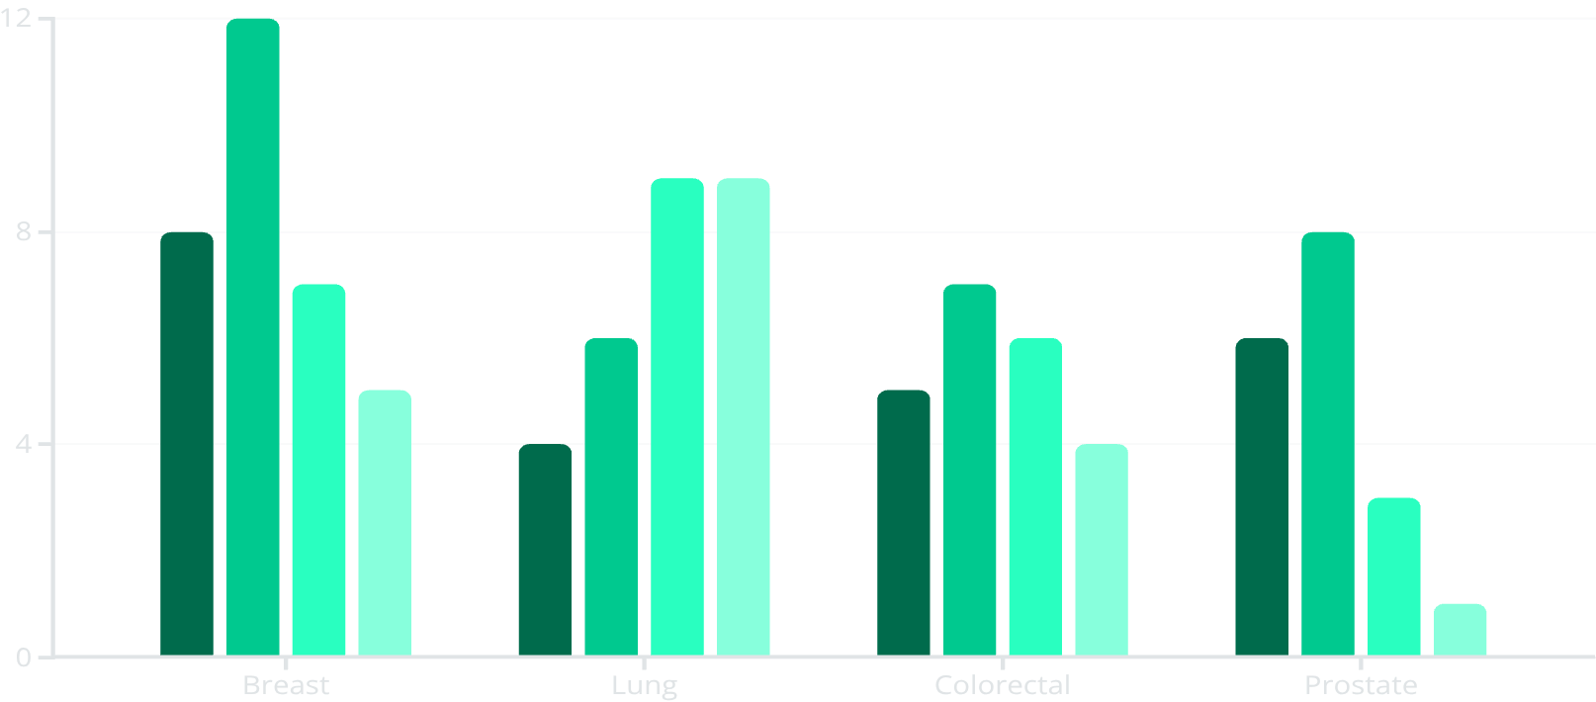
Cancer Type & Stage Analysis
Cancer Stage Distribution
The data reveals concerning patterns in diagnosis timing:
Breast cancer: Most cases detected at Stage II (37.5%)
Lung cancer: 64% of cases detected at advanced stages (III & IV)
Stage I
Stage II
Stage III
Stage IV
Prostate cancer: Highest early detection rate (78% at stages I & II)
Overall, 42% of all cancers detected at advanced stages

Slide 8
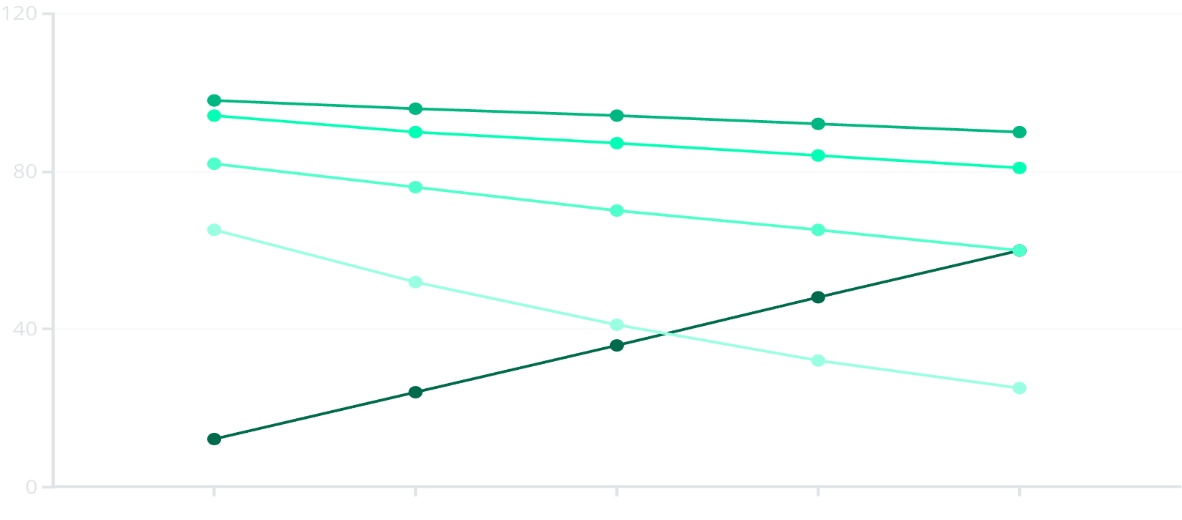
Treatment Outcomes Dashboard
Survival Rate Analysis
5-year survival rates show significant variance by stage:
Stage I: 90% (excellent outcomes)
Stage II: 81% (good outcomes)
Stage III: 60% (moderate outcomes)
Months After Treatment
Stage I
Stage II
Stage IV: 25% (poor outcomes)
Stage III
Stage IV
The data clearly demonstrates the critical importance of early detection, with a 65% difference in 5-year survival between Stage I and Stage IV diagnoses.

Slide 9
Key Insights
Early Detection Impact
Treatment Response Patterns
Patients diagnosed at Stage I have a 3.6x higher 5-year survival rate compared to Stage IV patients. Each stage progression reduces survival probability by approximately 20-25%.
Breast cancer shows the best treatment response (84% positive outcome), while lung cancer has the poorest response (52% positive outcome), likely due to later-stage diagnosis.
Demographic Disparities
Treatment Protocol Effectiveness
Significant disparities exist in early detection rates across demographic groups, with lower-income patients 2.3x more likely to be diagnosed at advanced stages.
Combined therapy approaches (surgery + chemotherapy + immunotherapy) show 27% higher effectiveness than single-modality treatments for comparable cases.

Slide 10
Recommendations
Clinical Recommendations
Data Infrastructure Improvements
Implement targeted screening programs for high-risk populations to improve early detection rates
Enhance data collection for social determinants of health to better understand demographic disparities
Standardize multi-modal treatment protocols based on data-driven effectiveness metrics
Implement real-time treatment response tracking dashboards
Develop personalized follow-up schedules based on recurrence risk factors
Develop predictive models for treatment outcome forecasting
Integrate genomic data with clinical outcomes for precision medicine initiatives
Next steps: Implement quarterly review of KPIs and establish a cross-functional team to prioritize and execute these recommendations.

Slide 11
Future Research
Genomic Biomarker Discovery
AI-Powered Outcome Prediction
Investigate the correlation between specific genetic mutations and patient outcomes to identify novel biomarkers for diagnosis, prognosis, and personalized treatment selection.
Develop and validate advanced machine learning models to forecast individual patient responses to various treatments and predict the likelihood of disease recurrence, enabling proactive interventions.
SDOH Impact on Disparities
Long-Term Quality of Life
Conduct in-depth research into how socioeconomic factors, access to care, and environmental exposures influence cancer incidence, treatment adherence, and survival rates across diverse patient populations.
Explore the long-term physical and psychological well-being of cancer survivors, identifying factors that contribute to improved quality of life and developing supportive care interventions.

Slide 12
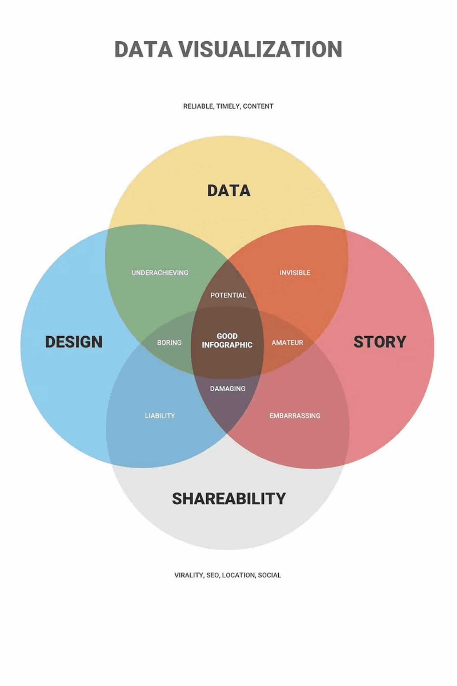
Limitations of Analysis
Data Granularity & Completeness
1
Incomplete records and inconsistent data formats, especially for long-term follow-up or detailed treatment responses, can limit comprehensive analysis.
Observational Bias
2
Reliance on retrospective observational data can introduce selection bias, making it challenging to establish direct causality between specific treatments and outcomes.
Generalizability
3
Findings may be limited to the specific patient cohort and not fully generalizable to broader, more diverse populations due to regional or institutional data sources.
Addressing these limitations requires ongoing efforts in data standardization, integration, and prospective study design for future research.

Slide 13




Visualizing Insights
Effective data visualization is crucial for transforming complex patient data into clear, actionable insights. It enables stakeholders to quickly grasp trends, identify patterns, and make informed decisions.
Clarity & Simplicity
Accuracy & Integrity
Simplify complex datasets to ensure immediate understanding and easy interpretation, reducing cognitive load for viewers.
Represent data truthfully and without distortion, ensuring that conclusions drawn are reliable and statistically sound.
Insight & Storytelling
Engagement & Aesthetics
Uncover hidden patterns, correlations, and narratives within the data, guiding the audience toward key discoveries and actionable intelligence.
Design visually appealing and intuitive displays that capture attention and facilitate a deeper engagement with the information presented.

Slide 14
Survival Analysis Deep Dive
Beyond overall rates, a deeper survival analysis reveals nuanced impacts of treatment protocols and patient characteristics.
1
2
3
Treatment Modality
Age & Comorbidities
Early Intervention
Patients receiving a combination of surgery, chemotherapy, and radiation demonstrate significantly longer median survival times across all cancer types.
Younger patients (under 60) and those with fewer than two comorbidities exhibit improved survival outcomes, likely due to better treatment tolerance and overall health.
The strongest predictor remains stage at diagnosis. Early intervention for Stage I and II cancers results in vastly superior long-term survival rates.
Combination therapy: +18 months median survival
Stage I vs. IV: 3.6x greater 5-year survival
Patients <60: 15% higher 5-year survival
Single modality: -10 months median survival
Every stage progression: 20-25% survival reduction
No major comorbidities: 22% higher 5-year survival
This detailed breakdown informs more targeted treatment strategies and highlights key areas for patient support and early detection initiatives.

Slide 15
Exploring Alternative Algorithms
Beyond traditional statistical methods, advanced algorithms offer powerful capabilities to uncover complex patterns, improve predictive accuracy, and provide deeper insights into cancer patient data.
Machine Learning for Prognosis
Clustering for Patient Stratification
Utilizing algorithms like Random Forests and Gradient Boosting to predict patient survival, recurrence risk, and treatment response based on comprehensive datasets.
Applying unsupervised learning techniques to identify distinct patient subgroups with similar characteristics, aiding in personalized treatment strategies.
Causal Inference Models
Deep Learning for Image Analysis
Employing methods such as propensity score matching and instrumental variables to ascertain the true causal effects of specific interventions or treatments on patient outcomes.
Leveraging neural networks to analyze medical images (e.g., pathology slides, radiology scans) for automated tumor detection, staging, and treatment monitoring.

Slide 16





Data Privacy in Action
Safeguarding sensitive patient information is paramount. Our approach integrates robust security measures and ethical guidelines to ensure trust and compliance.
Data Anonymization
Regulatory Compliance
Patient identities are rigorously protected through advanced anonymization and pseudonymization techniques, ensuring data utility without compromising privacy.
Strict adherence to global data protection regulations, including HIPAA and GDPR, is maintained for all data handling, storage, and processing activities.
Secure Infrastructure
Ethical Framework
Utilizing encrypted databases and access controls, we ensure that patient data is stored securely and accessed only by authorized personnel for approved purposes.
An overarching ethical framework guides all data usage, prioritizing patient well-being and ensuring data is leveraged solely for beneficial research and clinical improvement.

Slide 17




Ethical Considerations in Data Analysis
Analyzing sensitive patient data demands an unwavering commitment to ethical principles. Our framework ensures that every step, from data collection to insight dissemination, upholds the highest standards of responsibility and trust.
Informed Consent & Autonomy
Algorithmic Fairness & Equity
Ensuring patients fully understand how their data will be used and providing clear, actionable consent mechanisms is paramount to respecting individual rights.
Proactively identifying and mitigating potential biases in data and algorithms to prevent discriminatory outcomes and ensure equitable benefits across all patient groups.
Beneficial Use & Non-Maleficence
Transparency & Accountability
Committing to using data analysis solely for the advancement of patient health and well-being, while rigorously avoiding any potential for harm or misuse.
Maintaining clear, auditable processes for data handling, analysis, and decision-making, ensuring that all stakeholders can understand and trust our methods.

